Slide 1
CS 7172 Parallel and Distributed Computation Message Queue
Kun Suo
Computer Science, Kennesaw State University
https://kevinsuo.github.io/

Slide 2
Outline
Message queue in OS
What is message queue in distributed system
Example of message queue: RocketMQ
Pub/Sub vs. Message queue

Slide 3
Revisit Message Queue in the OS
A linked list of messages, stored in the kernel and identified by the message queue identifier
Message Queuing overcomes the disadvantages of
less information (signal),
only passing unformatted byte streams (pipe), and limited buffer size

Slide 4
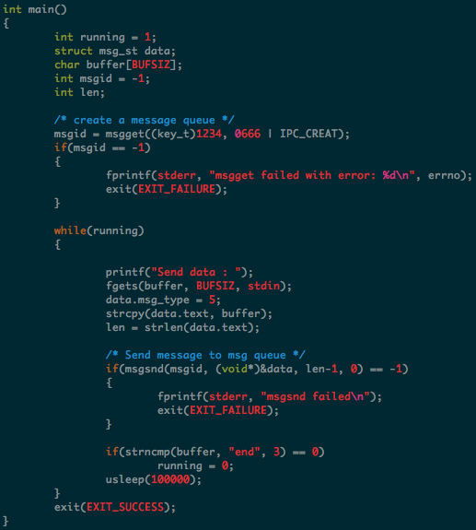
Message queue example
https://github.com/kevinsuo/CS3502/blob/master/msg_queue_sender.c
https://github.com/kevinsuo/CS3502/blob/master/msg_queue_receiver.c
Sender
s
id

Slide 5
Message queue example
https://github.com/kevinsuo/CS3502/blob/master/msg_queue_sender.c
https://github.com/kevinsuo/CS3502/blob/master/msg_queue_receiver.c
Sender
s
msgsnd
id
this is apple end

Slide 6
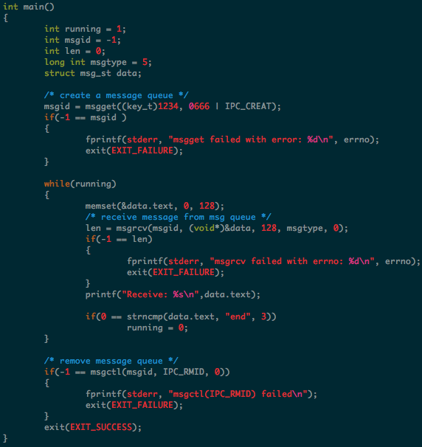
Message queue example
https://github.com/kevinsuo/CS3502/blob/master/msg_queue_sender.c
https://github.com/kevinsuo/CS3502/blob/master/msg_queue_receiver.c
r
Sender
Receiver
id
this is apple end

Slide 7
Message queue example
https://github.com/kevinsuo/CS3502/blob/master/msg_queue_sender.c
https://github.com/kevinsuo/CS3502/blob/master/msg_queue_receiver.c
r
Sender
Receiver
msgrcv
id
this is apple end

Slide 8
Message queue example
https://github.com/kevinsuo/CS3502/blob/master/msg_queue_sender.c
https://github.com/kevinsuo/CS3502/blob/master/msg_queue_receiver.c
r
Sender
Receiver
id
this is apple end
this is apple end

Slide 9
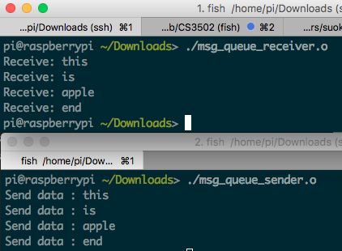
Message queue example
https://github.com/kevinsuo/CS3502/blob/master/msg_queue_sender.c
https://github.com/kevinsuo/CS3502/blob/master/msg_queue_receiver.c
r
Sender
Receiver
s
id
this is apple end
this is apple end

Slide 10
What is Message Queue in Distributed System?
Example: user use their email to register on a website
Check user information is valid or not. If yes, write into database; if no, return.
After written to database, system sends email notifications to end users
register
Registration information is written to database
user
Email notification

Slide 11
What is Message Queue?
Example: user use their email to register on a website
Check user information is valid or not. If yes, write into database; if no, return.
After written to database, system sends email notifications to end users
Synchronized communication
register
Registration information is written to database
user
Email notification
Takes 1000ms
Takes 400ms
Takes 600ms

Slide 12
What is Message Queue?
When using message queue:
Check user information is valid or not. If yes, write into database; if no, return.
After written to database, write message to the end of message queue
System gets message from queue, then sends email notifications to end users
register
Registration information is written to database
Message queue
user
Email notification
tail
head

Slide 13
What is Message Queue?
When using message queue:
Check user information is valid or not. If yes, write into database; if no, return.
After written to database, write message to the end of message queue
System gets message from queue, then sends email notifications to end users
Asynchronized communication
tail
head
register
Registration information is written to database
Message queue
user
Email notification
Takes 500ms
Takes 400ms
Takes 100ms
Takes 600ms

Slide 14
Message Queue can significantly reduce the request latency
Synchronized communication
register
Registration information is written to database
user
Email notification
Takes 400ms
Takes 600ms
Takes 1000ms
Asynchronized communication
tail
head
register
Registration information is written to database
Message queue
user
Email notification
Takes 500ms
Takes 400ms
Takes 100ms
Takes 600ms

Slide 15
What is Message Queue?
A message queue is implemented based on a queue. It stores message data in a specific format, such as a structure containing a message type, an ID that uniquely identifies the message, and the content of the message.
Messages can be returned directly after being placed in the tail of this queue.
The system does not need to process the message immediately. After that, other processes will read the messages from the head of the queue and process them one by one in the order in which the messages were placed.
Message queue can improve response speed and decouple between components inside the system.

Slide 16
How Message Queue Works?
The message queue model includes three core parts:
Producer: produce messages or data and insert them into the message queue.
Message queue: a first-in-first-out data structure for storing messages.
Consumer: get messages or data from the message queue for further processing.
tail
head
Message queue
Producer
Consumer
enqueue
dequeue

Slide 17
Example: RabbitMQ
RabbitMQ is lightweight and easy to deploy on premises and in the cloud. It supports multiple messaging protocols. RabbitMQ can be deployed in distributed and federated configurations to meet high-scale, high-availability requirements.
https://www.rabbitmq.com/

Slide 18
Example: RocketMQ
Apache RocketMQ is a unified messaging engine, lightweight data processing platform.
A distributed messaging and streaming platform with low latency, high performance and reliability, trillion-level capacity and flexible scalability
https://rocketmq.apache.org/

Slide 19
RocketMQ Architecture
Apache RocketMQ includes 4 parts:
NameServer Cluster, Producer Cluster, Broker Cluster and Consumer Cluster

Slide 20
RocketMQ Architecture
NameServer Cluster:
Like ZooKeeper in Kafka, provide lightweight service discovery, routing and management
Is responsible for manage information for Broker, such as ID, address, etc.

Slide 21
RocketMQ Architecture
Producer Cluster:
Interact with NameServer Cluster for consumer information
Is responsible for sending messages to message queue(e.g., broker cluster)

Slide 22
RocketMQ Architecture
Consumer Cluster:
Interact with NameServer Cluster for producer information
Is responsible for receiving messages from message queue(e.g., broker cluster)

Slide 23
RocketMQ Architecture
Broker Cluster:
Store the message data which is sent from producers and received from consumers

Slide 24
RocketMQ Architecture
Broker Cluster:
Every broker is implemented as master-slave mode for high reliability.
Master can read and write while the slaves can only read.
Master receives messages from producers and syncs all data with slaves.

Slide 25
How Broker Cluster works as Message Queue?
Get topic position in brokers
Get topic position in brokers
heartbeat
heartbeat
heartbeat
Send
Receive

Slide 26
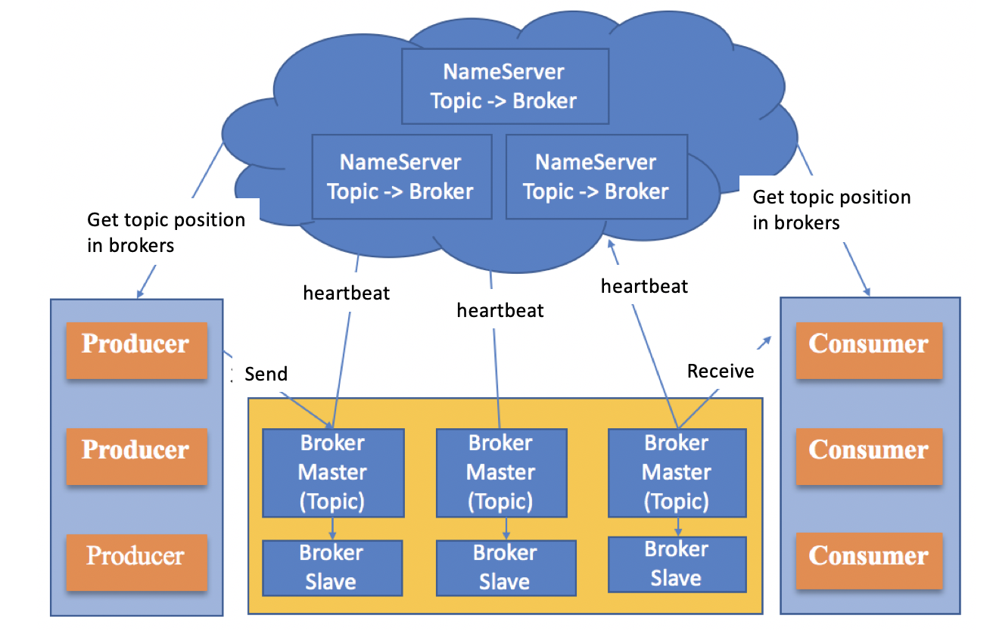
How Broker Cluster works as Message Queue?
Topic refers to message types or data types
Each broker only stores part of one topic data to achieve high reliability

Slide 27
How Broker Cluster works as Message Queue?
1.3 Broker registers itself to NameServer and sends heartbeat and updates to NameServer periodically
1.1 Namserver is booted
1.2 Broker is booted

Slide 28
How Broker Cluster works as Message Queue?
2. NameServer creates topics and distributes topics into different brokers

Slide 29
How Broker Cluster works as Message Queue?
3.1 Producers get the broker locations for some topics from NameServers
3.2 Producers send messages to corresponding brokers

Slide 30
How Broker Cluster works as Message Queue?
4.1 Consumers get the broker locations for some topics from NameServers
4.2 Consumers receive messages from corresponding brokers

Slide 31
Pub/Sub model vs. Message Queue model
Data structure
Similarity:
The publish-subscribe model and message queue both use a message center, which stores data published by producers
They all have concepts such as topics and brokers
Difference:
The publish-subscribe model uses maps or arrays to implement the message center
Message queue adopts First-in, first-out queue structure

Slide 32
Pub/Sub model vs. Message Queue model
Decoupling method
Pub/Sub model:
Consumers need to subscribe the topics in advance. After the producers publish the data to the message center, the message center pushes the data to consumers according to the subscriber's information.
Message Queue model:
Producers publish data to the message queue, and the message queue will store the data, waiting for consumers to obtain data on demand

Slide 33
Pub/Sub model vs. Message Queue model
Scenario
Pub/Sub model:
Consumers are required to subscribe to messages from the message center in advance.
The message center needs to obtain consumer information in advance, which is more suitable for scenarios where consumers are long lived processes or services.
Message Queue model:
The message queue does not need to obtain consumer information in advance, so it is more flexible for consumers and suitable for scenarios where consumers are temporary users or services

Slide 34
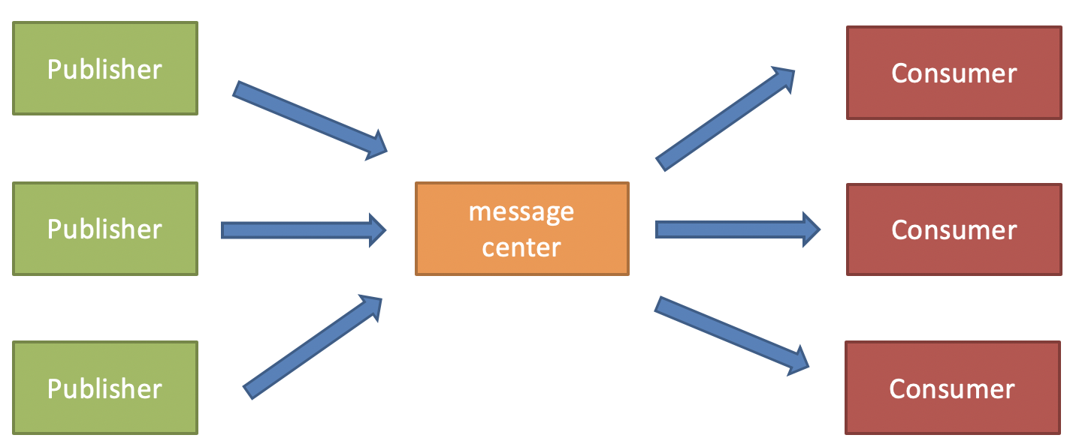
How to send message from one to another?
Publish/Subscribe Model

Slide 35
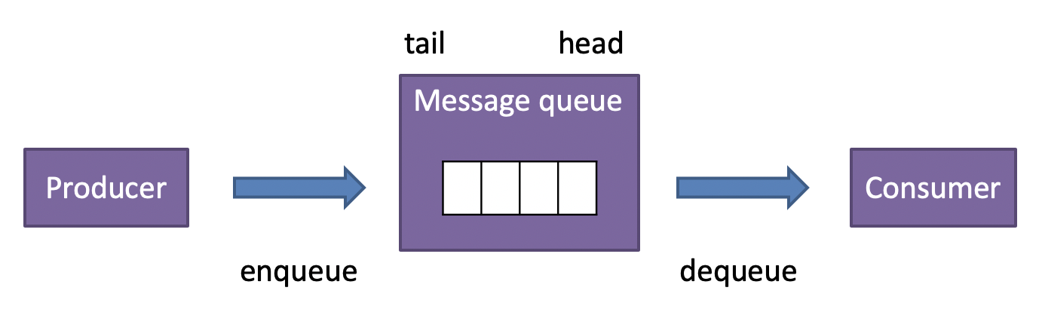
How to send message from one to another?
Message Queue model

Slide 36
Conclusion
Message queue in OS
What is message queue in distributed system
Example of message queue: RocketMQ
Pub/Sub vs. Message queue

